Slide 1

DSA ALGORITHM LAB
PBL REVIEW 3 EVALUATION
LARGE-SCALE TEXT ANALYTICS PLATFORM
Advanced Algorithm Laboratory
An interactive educational & benchmarking laboratory for visualizing, evaluating, and profiling text analytics algorithms across large-scale corpora.
Lakshith
Rahul
Ranadeep
Jivith
Varshith
Visualization & Frontend
Benchmarking Engine
Dataset Management
UI & Integration Testing
Backend Development

Slide 2
PROJECT OVERVIEW
RUBRIC: TECHNICAL COMPETENCE (10 MARKS)
Bridging Algorithm Theory & Real Compute
Empirical laboratory replacing static textbook proofs with live server-side execution telemetry and performance measurement.
18,846
22.04M
12
Dataset Documents
Processed Characters
Algorithms Integrated
Large-scale corpus integrated across 20 distinct categories.
Real-time workload evaluation for large-scale text analytics.
Exact pattern search, multi-pattern, vector space, and similarity models.

Slide 3
)
4 CORE ALGORITHM CATEGORIES
Comprehensive 12-Algorithm Engine
Exact Pattern Matching
Multi-Pattern & Trees
Similarity & Vector Space
Naive, KMP, Rabin-Karp, Boyer-Moore.
Aho-Corasick, Trie, Suffix Array, Kasai LCP.
Edit Distance, TF-IDF, Inverted Index, Text Similarity.
Sub-linear pattern search guarantees with prefix/suffix shift tables.
Automata-driven dictionary matching and full-text index structures.
Dynamic programming alignment and term relevance ranking.

Slide 4
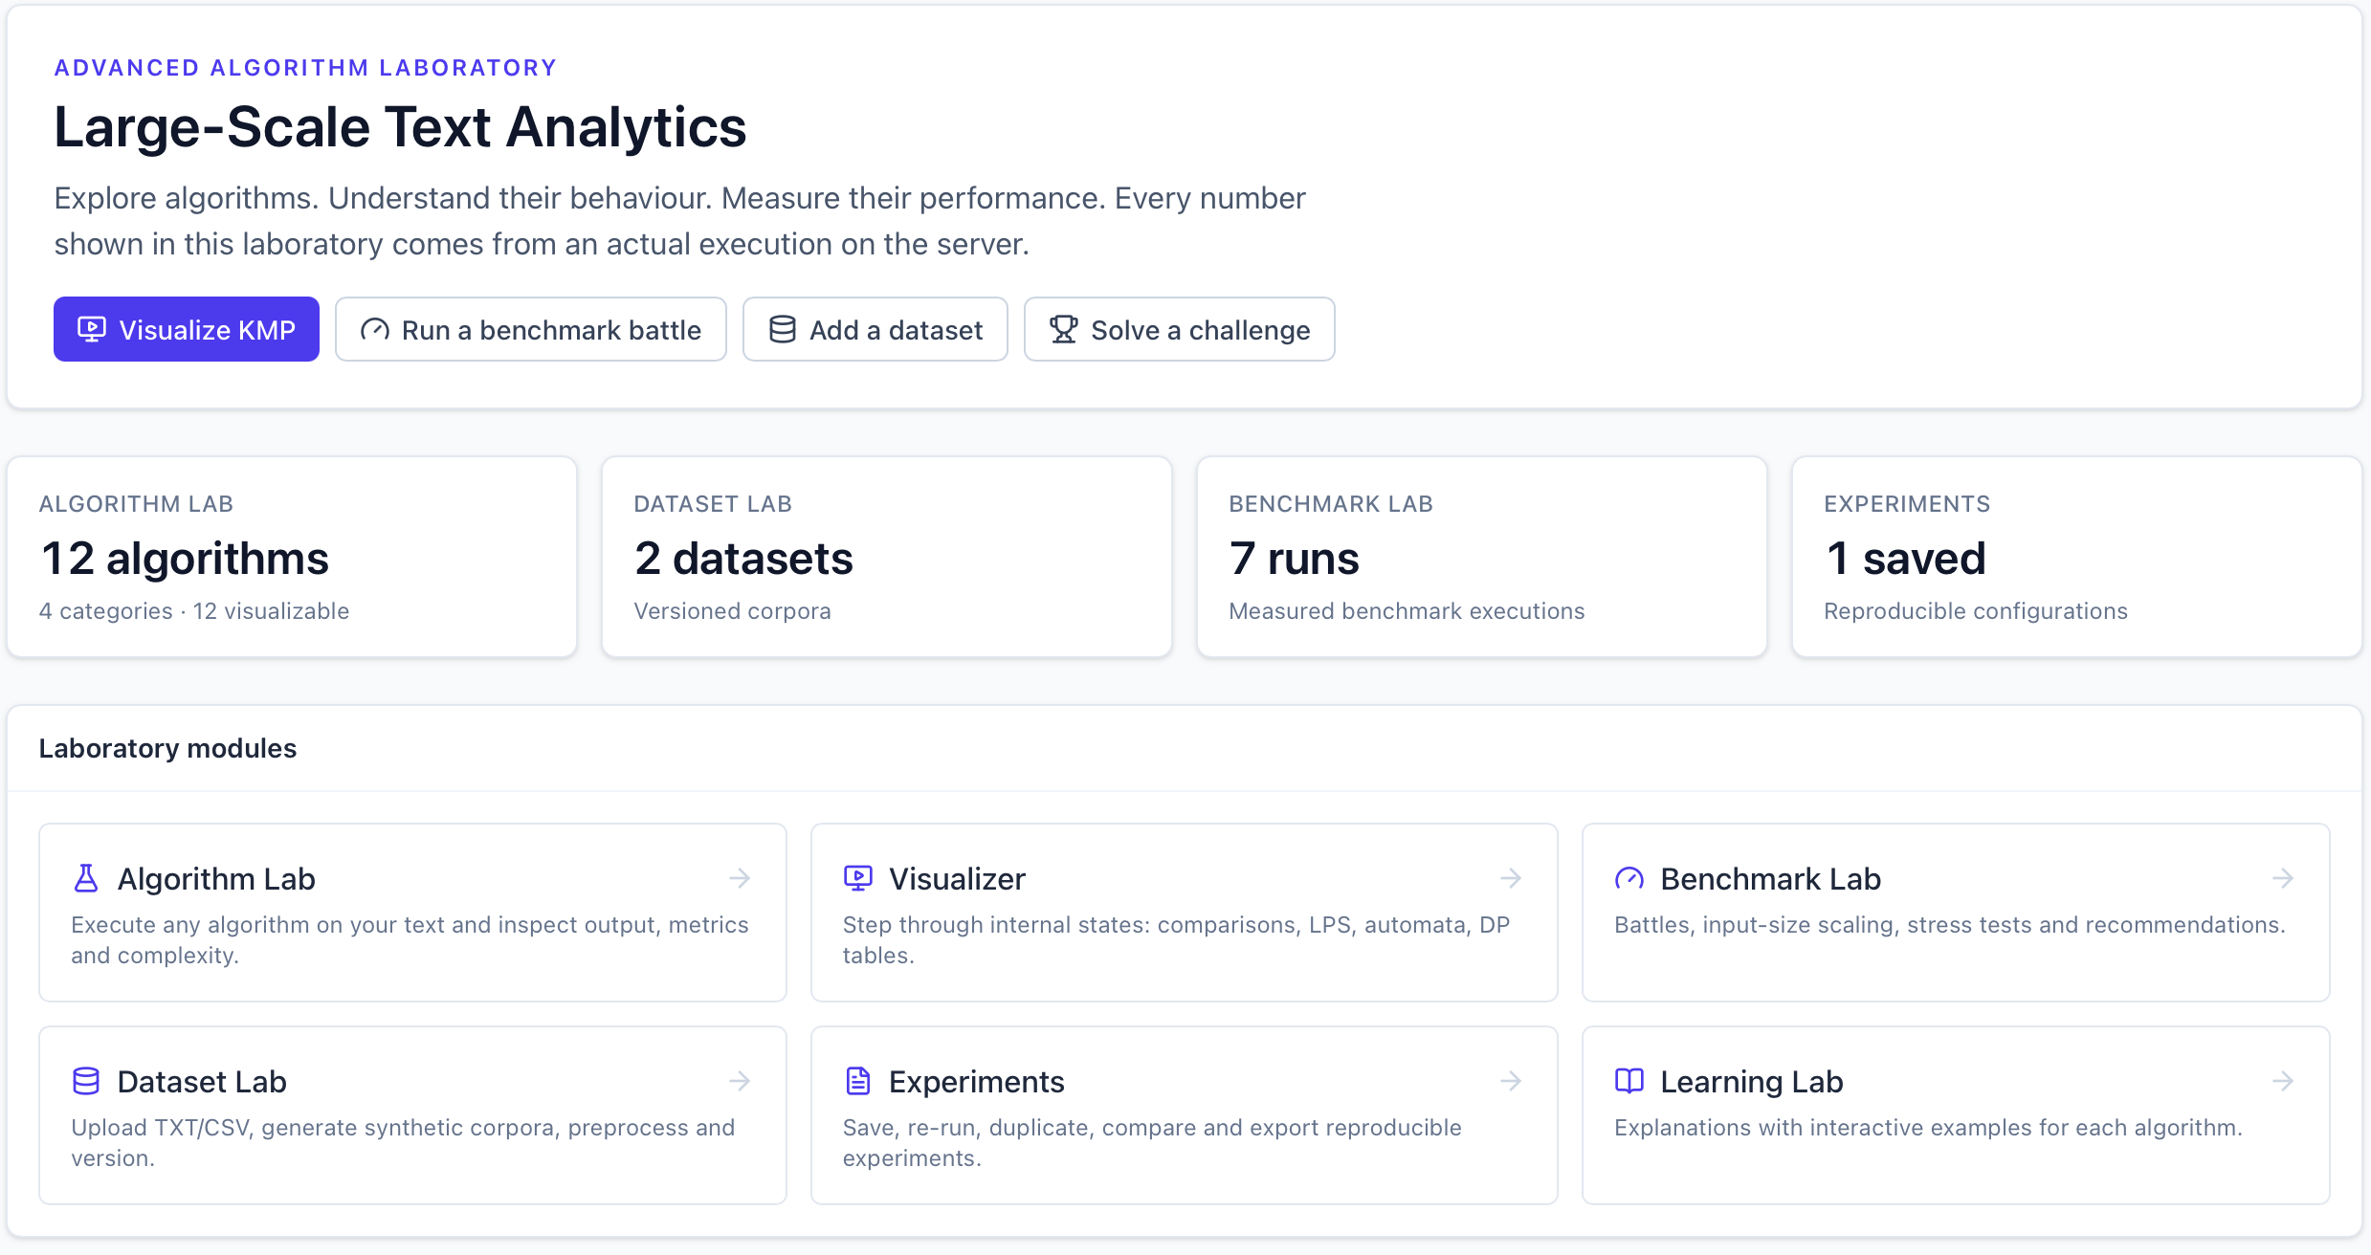
SYSTEM ARCHITECTURE & DASHBOARD
Unified Laboratory Workspace & Telemetry
Interactive Dashboard Hub
Centralized navigation across 8 specialized laboratory modules.
Real-Time Server Benchmarks
Every number measured live on the backend server at request time.
Integrated Performance Charts
Automated throughput tracking comparing exact matching strategies.

Slide 5
SERVER-SIDE MEASUREMENTS
Empirical Runtime & Memory Profiling
ALGORITHM | WORKLOAD | RUNTIME (MS) | PEAK MEMORY | EVALUATION REMARKS
Inverted Index | 2,000 chars | 0.1714 ms | 37.10 KB | Fastest overall search performer.
Text Similarity | 2,000 chars | 0.2500 ms | 40.37 KB | Highly efficient vector space scoring.
TF-IDF | 2,000 chars | 0.3068 ms | 33.28 KB | Optimal balance for document retrieval.
Rabin-Karp | 2,000 chars | 1.9310 ms | 10.41 KB | Lowest measured memory footprint.
Edit Distance | 2,000 chars | 6.9000 ms | ~630 KB | High memory overhead from DP matrix.

Slide 6
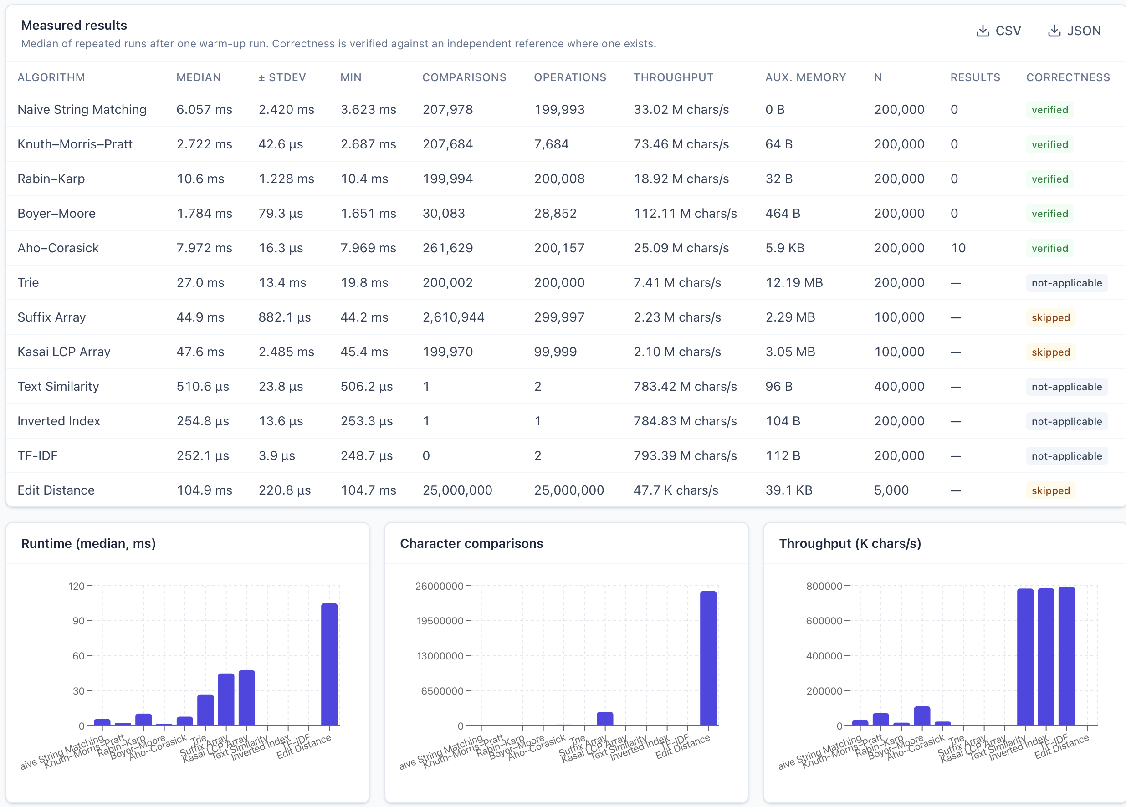

BENCHMARK BATTLE ENGINE
Controlled Multi-Algorithm Head-to-Head
Configurable Workload Seeds
Identical text inputs adapted cleanly across string matching and vector algorithms.
Scalable Input Control
Stress test inputs up to 200,000+ characters with custom repetition parameterizing.

Slide 7
SMART RECOMMENDATIONS
Next-Generation Laboratory Innovations
Algorithm Intelligence
Unified Comparison
Precision Profiling
Sustainable Compute
Automated recommendation engine mapping optimal algorithms to workload constraints.
Simultaneous multi-algorithm benchmarking on custom text inputs.
Microsecond runtime telemetry and Python memory allocation hooks.
Lightweight local processing minimizing heavy cloud compute reliance.

Slide 8



ACADEMIC & INDUSTRY VALUE
Educational Impact & Reproducibility
Reduced Cognitive Load
Reproducible Research
Open Academic Platform
Visual pointer tracing clarifies complex string matching logic step-by-step for students.
Standardized testbed across 22M+ character corpus for consistent academic benchmarking.
Extensible open-source architecture for introducing new NLP & text search algorithms.

Slide 9
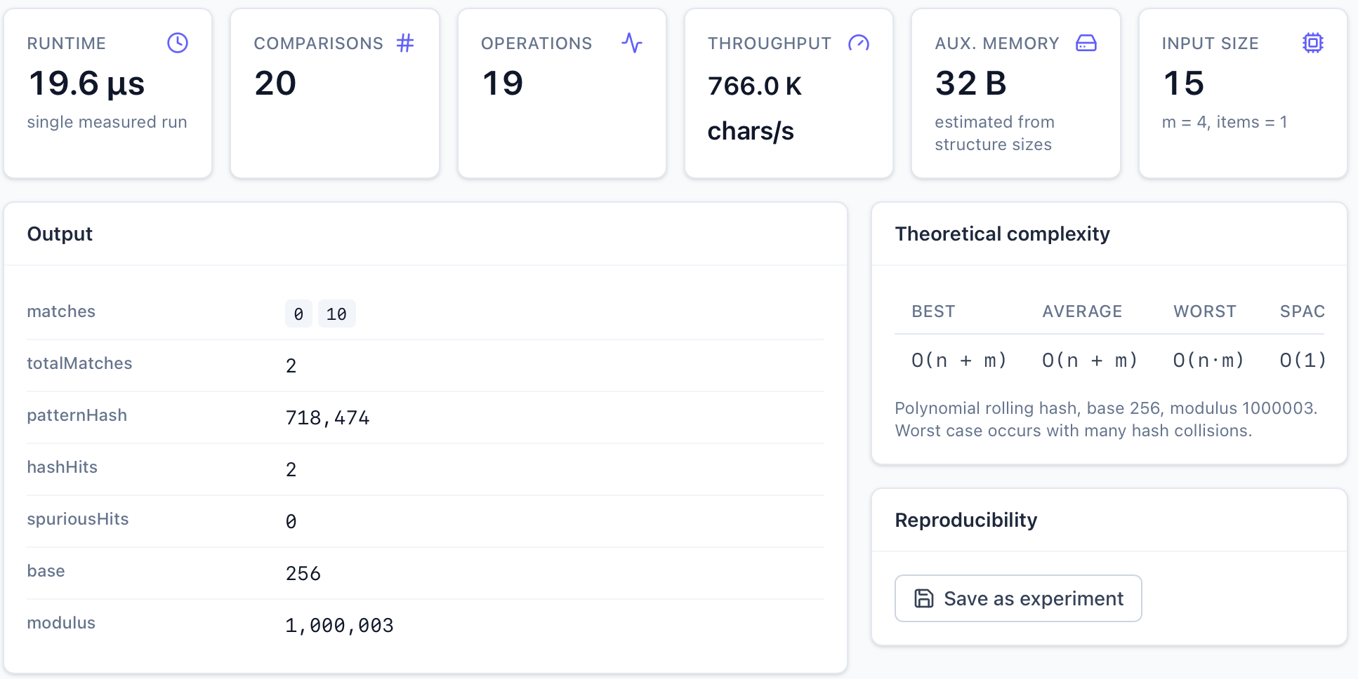
RECOMMENDATION HUB
Workload-Aware Recommendation Engine
Transparent Decision Rules
Considers task type, text size, pattern size, alphabet, and query frequency.
Algorithmic Scoring & Justification
Provides instant scores and structural reasons for selected algorithm recommendations.

Slide 10
PRESENTATION SKILLS & EVALUATION COMPLETE
Advanced Text Analytics Laboratory
Empirical Evaluation, Real-time Visualization, and Intelligent Benchmarking Engine
github.com/reddylakshith328-cloud/DSA-Algorithm_Comparision
Thank You — Ready for Questions & Discussion

